Slide 1
Modeling Supply and Demand Hospital Bed Imbalances in Texas and Their Contributing Cultural Factors
Michael Tiefelsdorf
The University of Texas at Dallas
tiefelsdorf@utdallas.edu
Priyanka Vyas
San Jose State University
Amanuel Abuhay
The University of Texas at Dallas
Virtual NARSC Meeting
November 11th, 2020
See the detailed analysis at http://www.spatialfiltering.com/ThinkR/Downloads/HospitalAccessInTX.html

Slide 2
Introduction: Problem Statement
In most counties Texas’s population base is rapidly expanding.
The health care supply has problems keeping up with this growth in demand.
In fact, in several rural counties the supply is shrinking, e.g., due to hospital closures.
A well-known imbalance between demand and supply exist on several spatial scales:
within metropolitan areas
remote rural regions versus more urbanized regions

Slide 3
Introduction: Objectives
Estimate with an economic supply and demand modeling approach potential imbalances between available hospital beds and the underlying population need in Texas.
Explain the estimated imbalances on the county level with exogenous factors in an econometric spatial regression model.

Slide 4
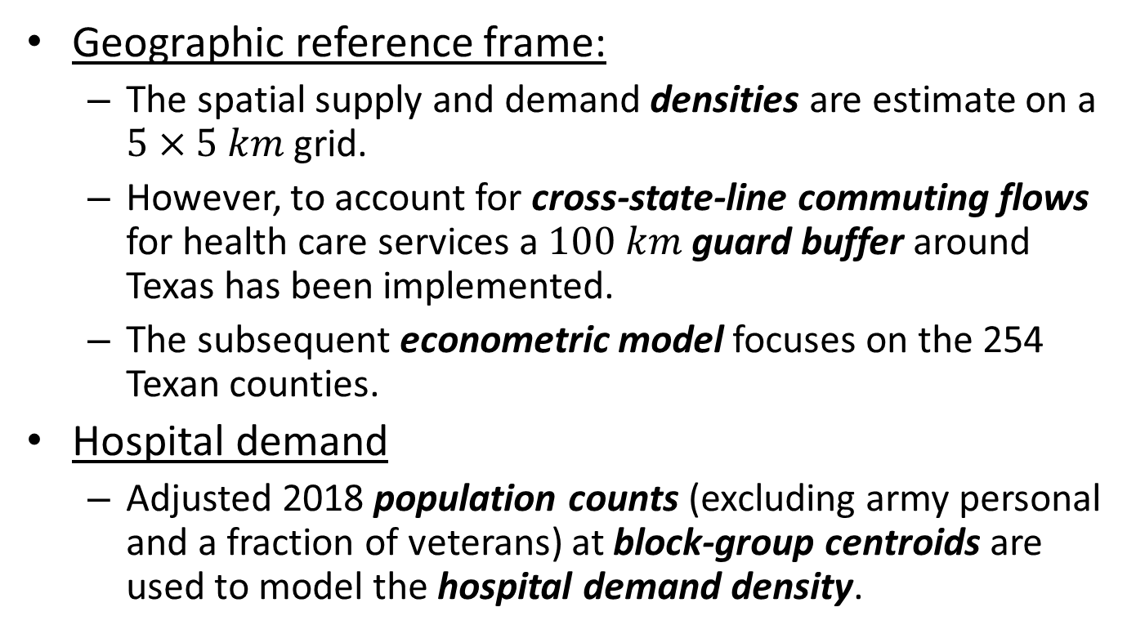
Data Sources (i)
Geographic reference frame:
The spatial supply and demand densities are estimate on a $5×5 km$ grid.
However, to account for cross-state-line commuting flows for health care services a $100 km$ guard buffer around Texas has been implemented.
The subsequent econometric model focuses on the 254 Texan counties.
Hospital demand
Adjusted 2018 population counts (excluding army personal and a fraction of veterans) at block-group centroids are used to model the hospital demand density.

Slide 5
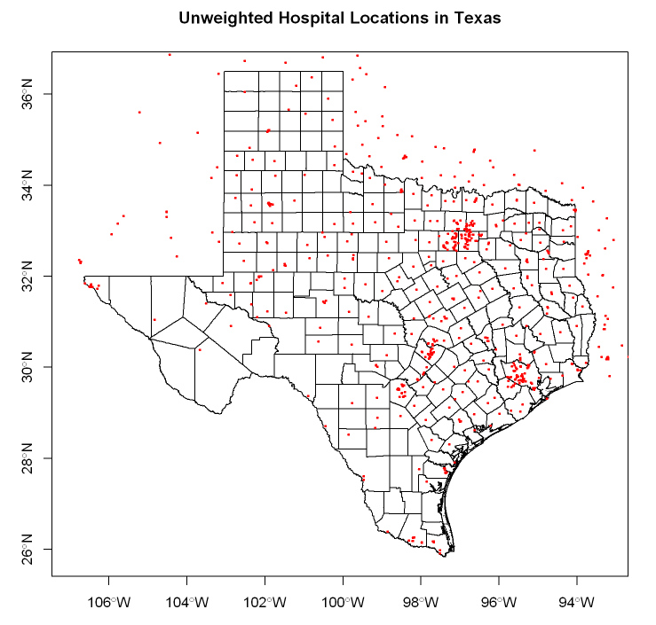
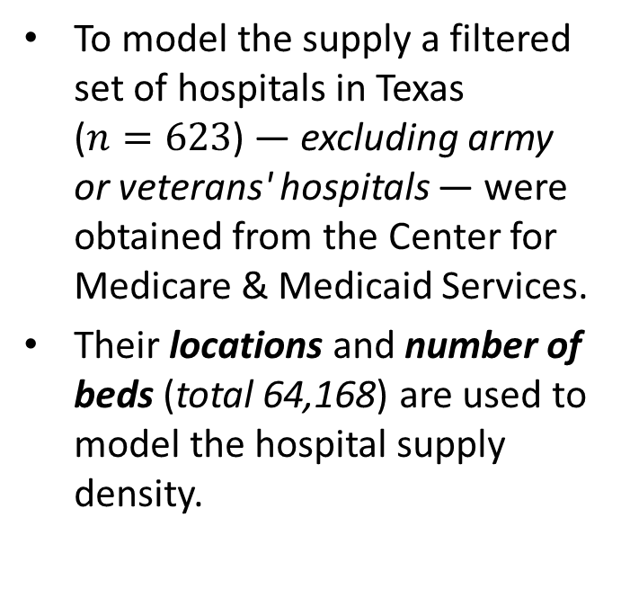
Data Sources (ii)
Hospital Supply
Hospital Locations (incl. buffer)
To model the supply a filtered set of hospitals in Texas ($n=623$) — excluding army or veterans' hospitals — were obtained from the Center for Medicare & Medicaid Services.
Their locations and number of beds (total 64,168) are used to model the hospital supply density.
Notes:
Discuss that the hospital density follows the population density.

Slide 6
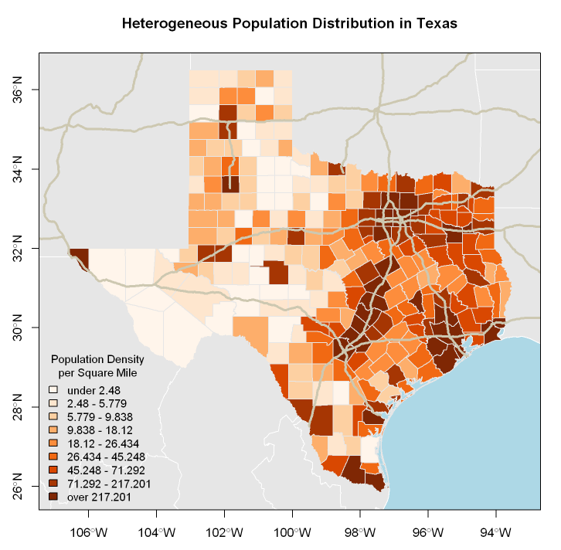
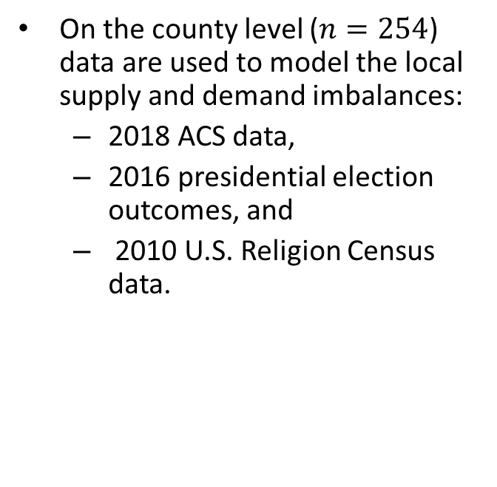
Data Sources (iii)
Exogenous Factors
Population Distribution in TX
On the county level ($n=254$) data are used to model the local supply and demand imbalances:
2018 ACS data,
2016 presidential election outcomes, and
2010 U.S. Religion Census data.
Notes:
Discuss the heterogenous population density with the less populated Panhandle and West Texas

Slide 7
Challenges Identifying the Supply and Demand Surfaces
Hospital bed supply:
The catchment area around the hospitals varies widely following the population density pattern.
The capacity of hospitals is heterogeneous.
Population demand:
The activity field of the population varies widely from metropolitan to rural locations.
The population count in the block-groups is heterogeneous.
Solution:
Model the supply and demand surfaces with an adaptive and weighted kernel density estimator

Slide 8
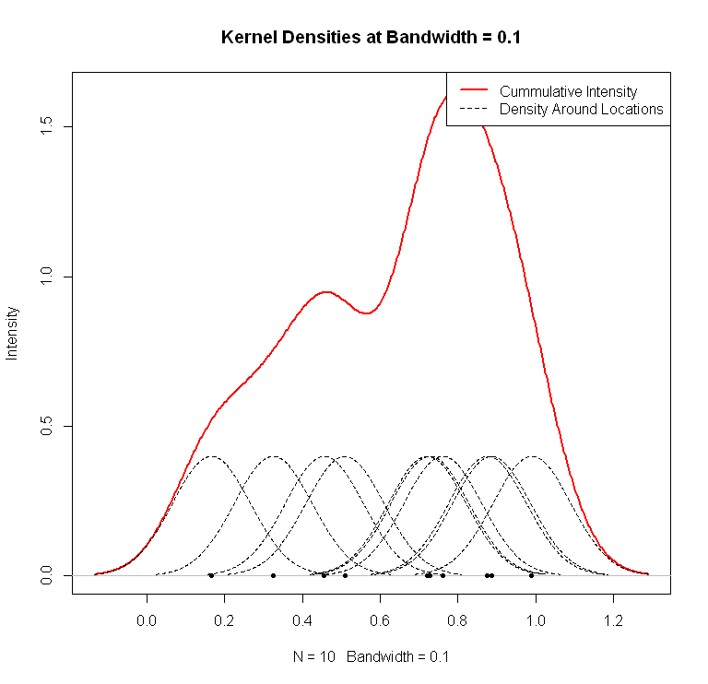
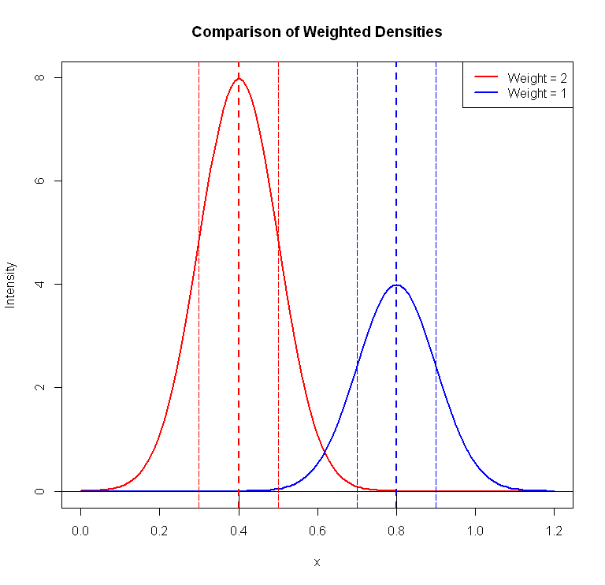
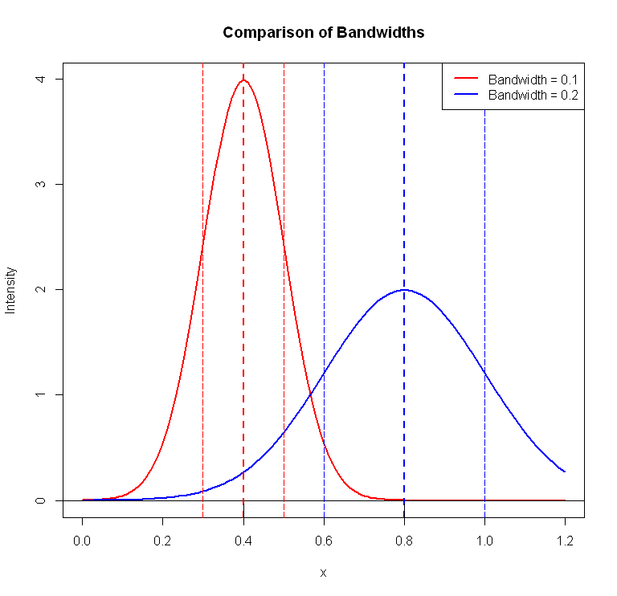
Concepts: Weighted & Adaptive Kernel Densities
Construction of kernel densities around generator points.
Impact of varying weights  change of mass under curve.
Impact of varying bandwidth  change of spatial reach under curve.
Enables the prediction of the demand and supply surfaces by spatial interpolation.
The number of beds and population count provide the weights.
Bandwidth determines the hospital catchment areas and population activity fields.

Slide 9
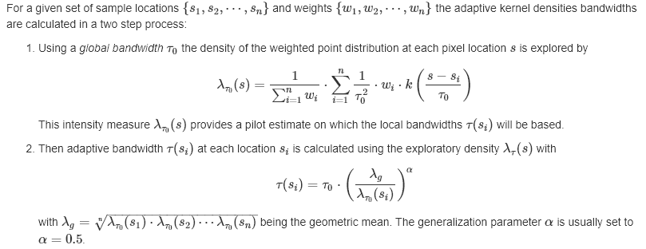
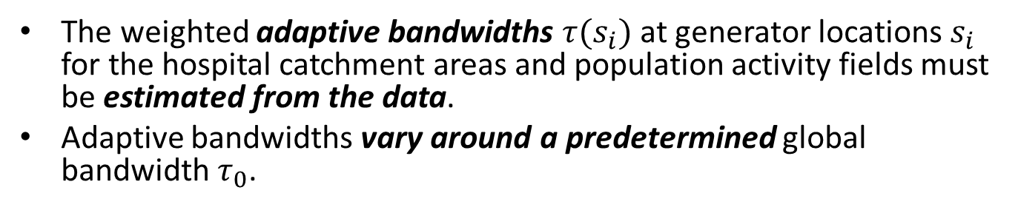
Challenge: Estimating adaptive Bandwidths (i)
The weighted adaptive bandwidths $τ(s_{i})$ at generator locations $s_{i}$ for the hospital catchment areas and population activity fields must be estimated from the data.
Adaptive bandwidths vary around a predetermined global bandwidth $τ_{0}$.

Slide 10
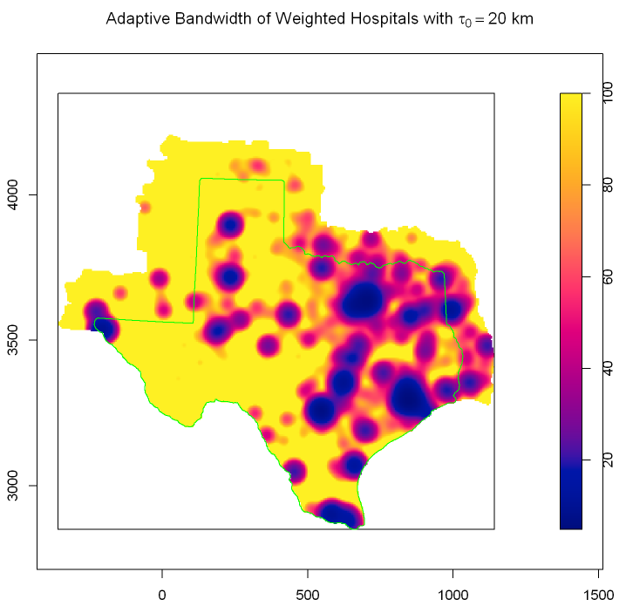
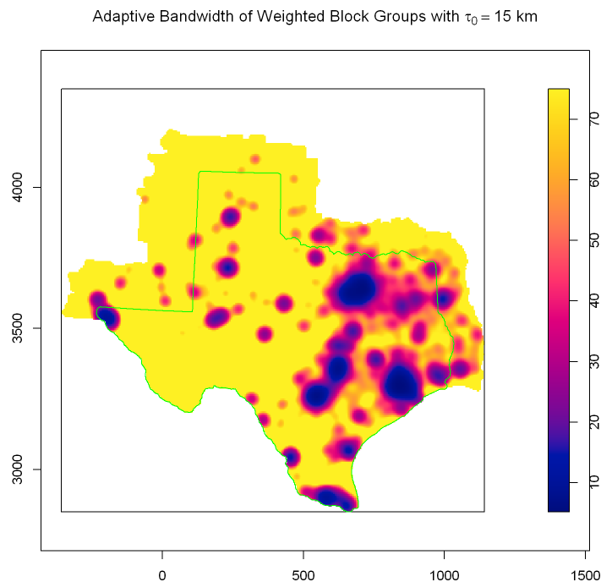
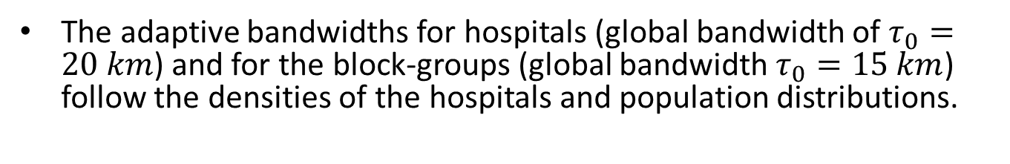
Challenge: Estimating adaptive Bandwidths (ii)
The adaptive bandwidths for hospitals (global bandwidth of $τ_{0}=20 km$) and for the block-groups (global bandwidth $τ_{0}=15 km$) follow the densities of the hospitals and population distributions.

Slide 11
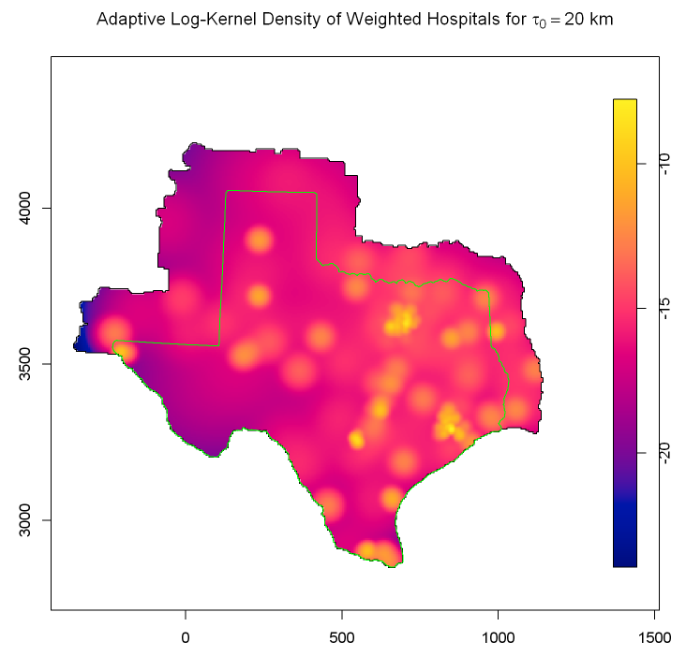
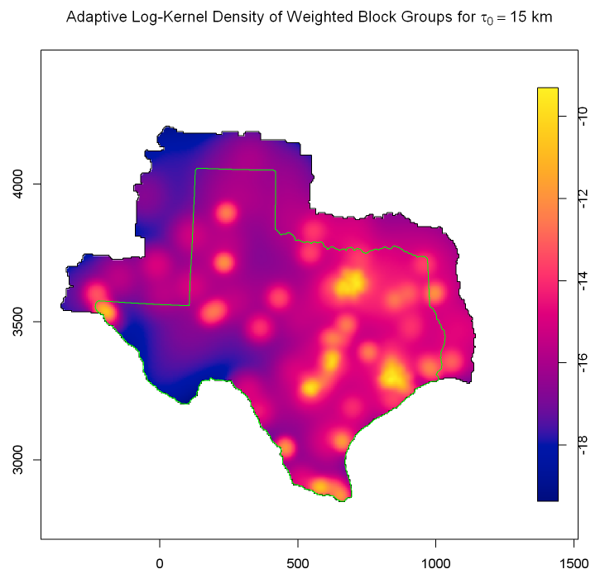
Identifying the Supply and Demand Imbalance (i)
The differences at the pixel level of both log-density surfaces are used to model the supply and demand imbalances by means of a log-relative risk surface.

Slide 12
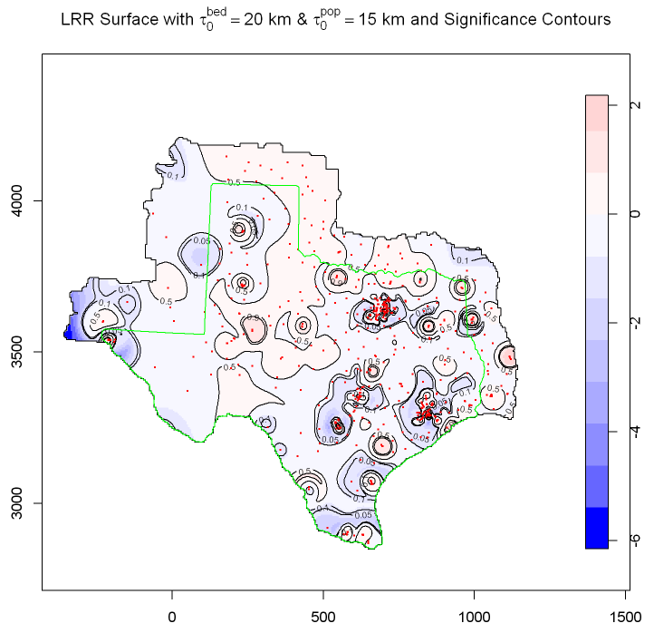
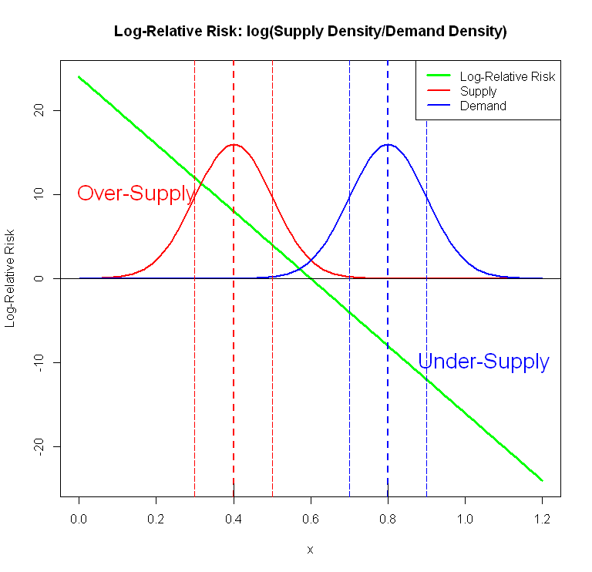
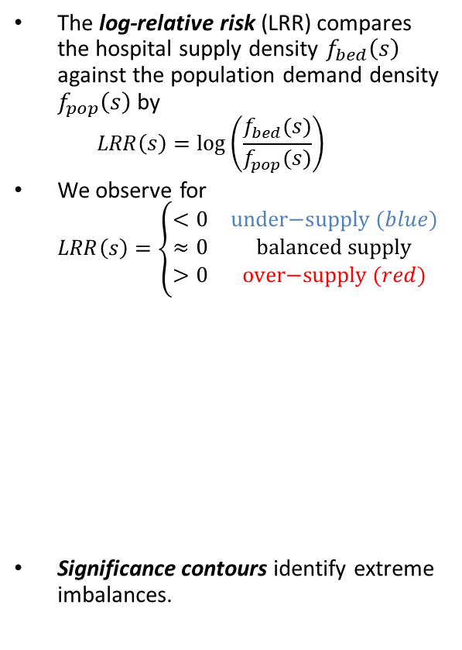
Identifying the Supply and Demand Imbalance (ii)
The log-relative risk (LRR) compares the hospital supply density $f_{bed}\left(s\right)$ against the population demand density $f_{pop}\left(s\right)$ by $LRR\left(s\right)=\log\left(\frac{f_{bed}(s)}{f_{pop}(s)}\right)$
We observe for $LRR\left(s\right)=\left\{\begin{matrix}<0 & \text{under}\text{−}\text{supply} (blue) \\ ≈0 & \text{balanced} \text{supply} \\ >0 & \text{over}\text{−}\text{supply} (red)\end{matrix}\right.$
Significance contours identify extreme imbalances.

Slide 13
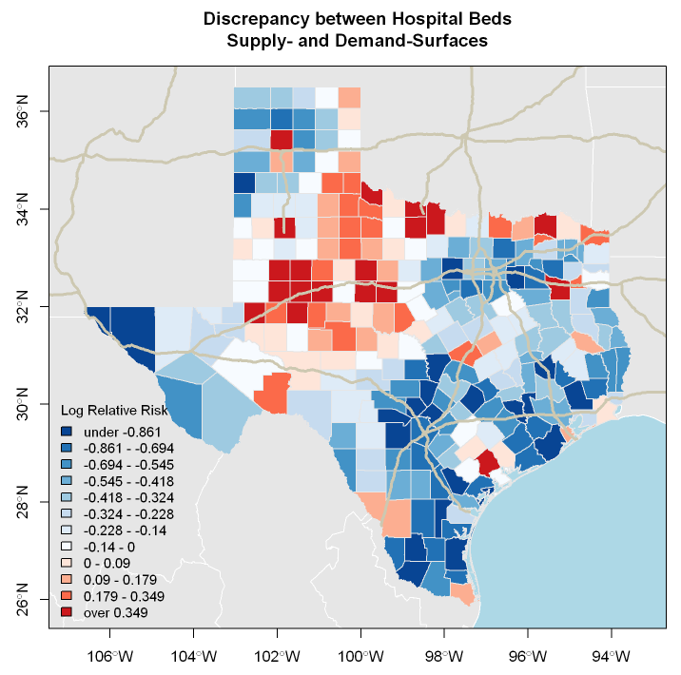
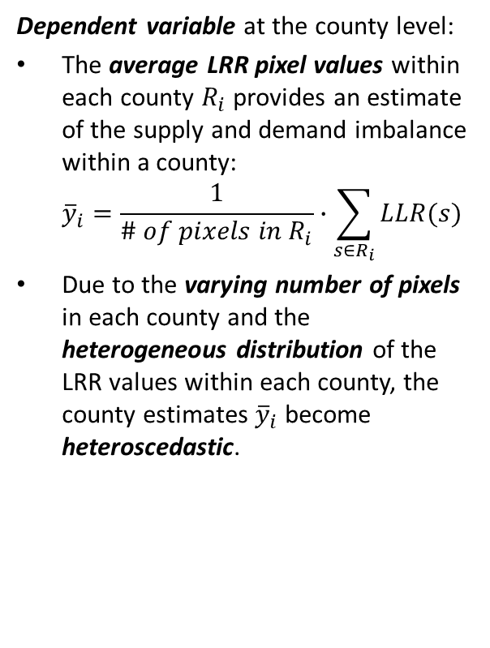
Aggregating Pixel LRR into the County Level
Dependent variable at the county level:
The average LRR pixel values within each county $R_{i}$ provides an estimate of the supply and demand imbalance within a county: ${\overline{y}}_{i}=\frac{1}{\# of pixels in R_{i}}∙\sum_{s∈R_{i}}{LLR(s)}$
Due to the varying number of pixels in each county and the heterogeneous distribution of the LRR values within each county, the county estimates ${\overline{y}}_{i}$ become heteroscedastic.

Slide 14
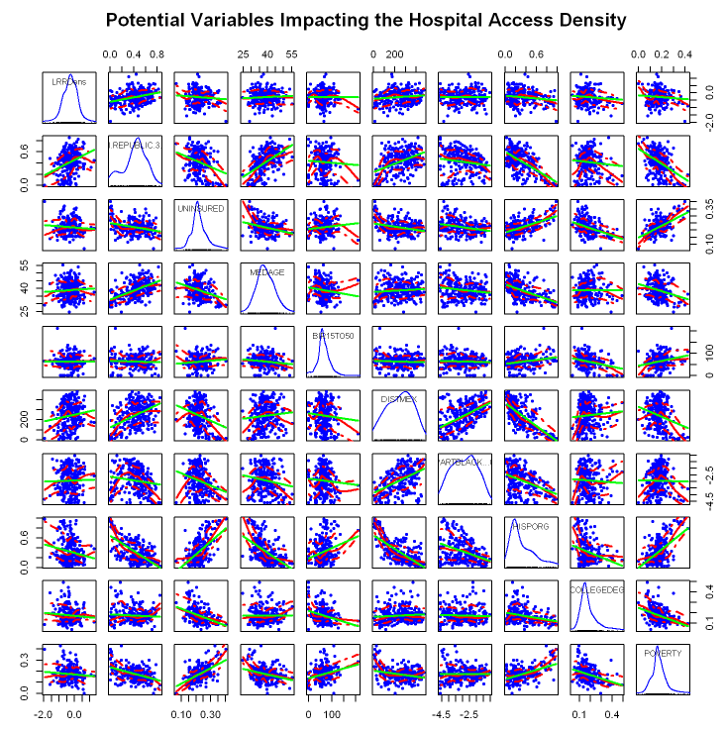
Relationship between Potential Explanatory Variables and County Level Supply and Demand Imbalances (i)
If necessary, the exogenous variables are Box-Cox transformed to aid linearity of the pairwise relationships.

Slide 15
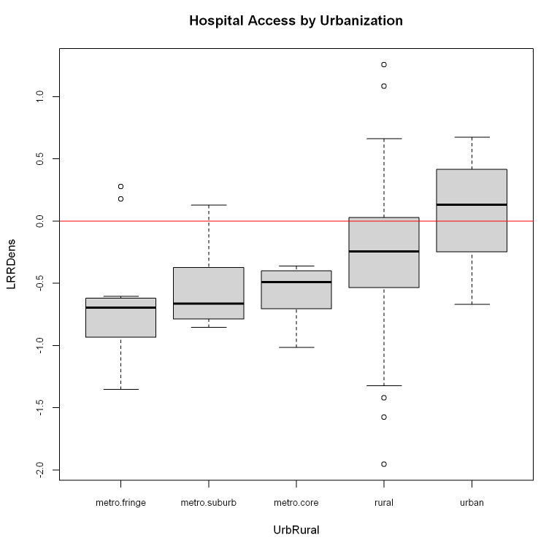
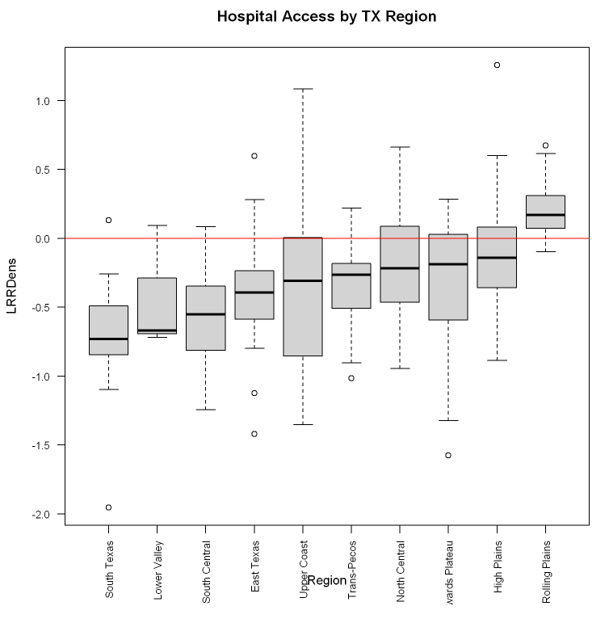
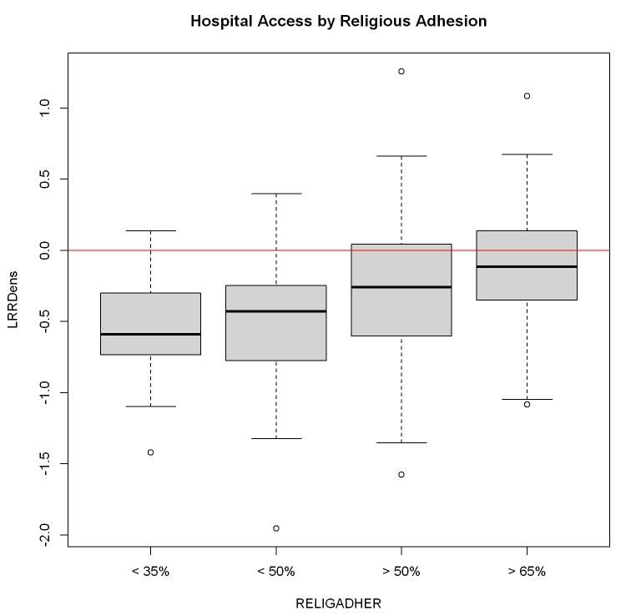
Relationship between Potential Explanatory Factors and County Level Supply and Demand Imbalances (ii)

Slide 16
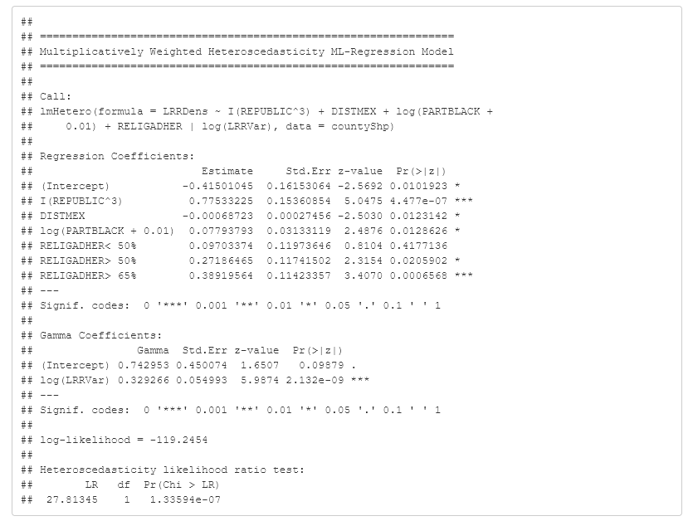
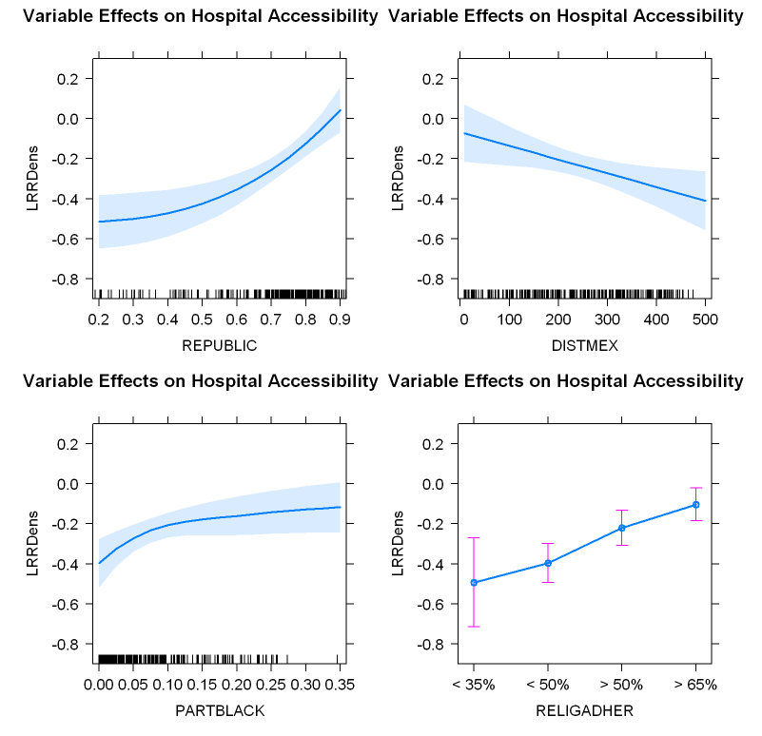
Final Model Using Cultural Variables and Adjusting for Heteroscedasticity

Slide 17
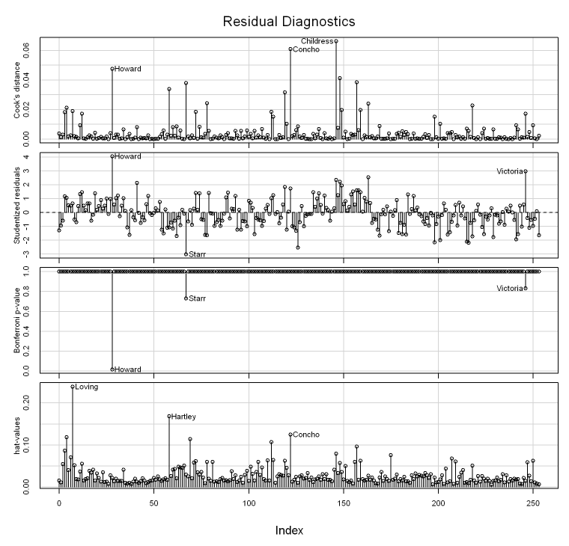
Aspatial Model Diagnostics
Absence of aspatial model violations:
None of the independent variables are multicollinear.
Stark non-linearities are not present.
The residuals are normally distributed.
Just Howard County (central TX along I 20) is a potential outlier and influential observation. Its over-supply is substantially higher than expected, perhaps due to a concentration of state hospitals.

Slide 18
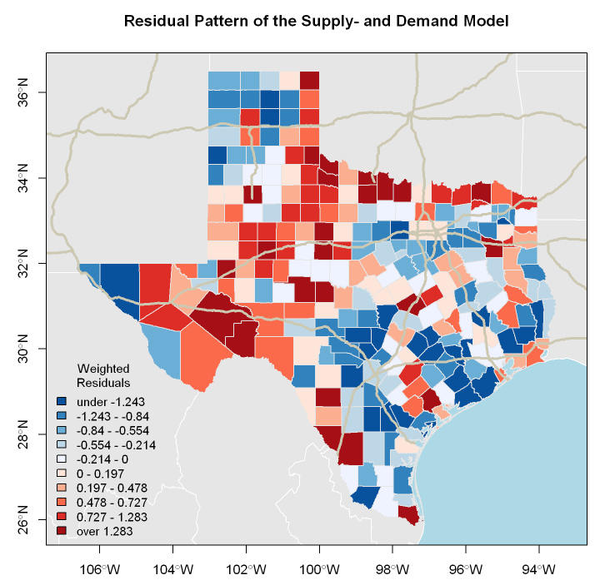
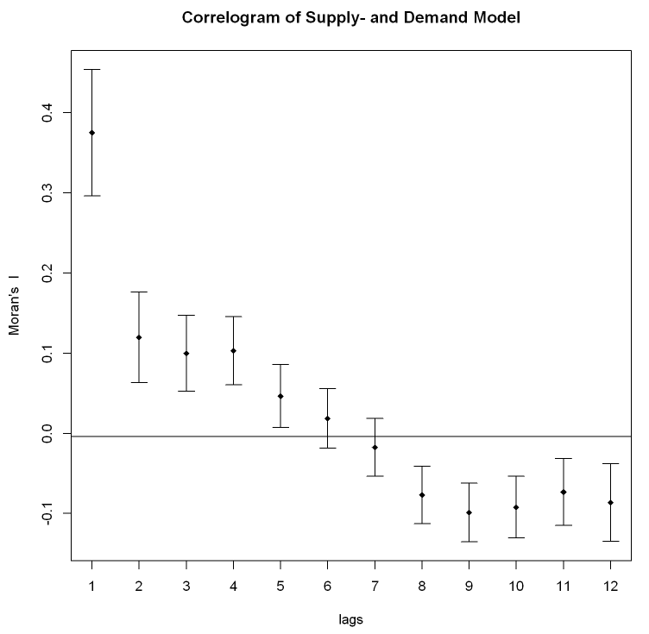
Spatial Model Diagnostics
Spatial autocorrelation is expected due to the spatial spill-over characteristics of the kernel density smoother.
The residual pattern exhibit significant positive autocorrelation.
However, none of the standard spatial autoregressive models matches the pattern of the spatial correlogram.

Slide 19
Summary
The log-relative risks, which were introduced in spatial epidemiology, are applicable in economic regional studies of supply and demand imbalances.
The adaptive bandwidth estimates show that the average travel distance is
around 10 km in urban areas (~20 minutes travel time)
around 100 km in rural areas (~60 minutes travel time)
Some rural counties in the Hill Country and Panhandle exhibit an unexpected potential over-supply.
In general, the metropolitan fringe is under-supplied.
Cultural characteristics influence the supply and demand imbalance more than economic and demographic factors.

Slide 20
Conclusions
Spatial econometric models must account for heteroscedasticity of the spatial aggregates.
The spatial spill-over effects of spatial smoothers almost always induce spatial autocorrelation.
Heterogeneity in the demand of local populations and hospital efficiencies can be incorporated by adjusting the weights.
Individual hospitals could be disaggregated into wards with their bed counts to model varying catchment areas by specialization.
The proposed methodology can be applied in other fields of spatial studies, such as evaluating potential food deserts, i.e., demand for and supply of affordable and quality food.
For more information see: http://www.spatialfiltering.com/ThinkR/Downloads/HospitalAccessInTX.html

Slide 21
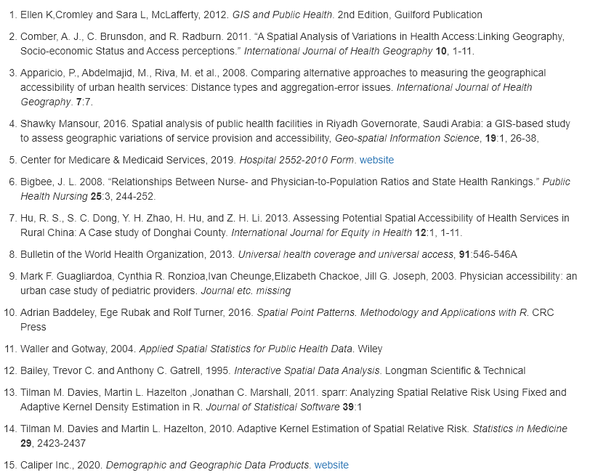
References

